Slide 1
Our characters are on a hilltop in the forest surrounding Shadar Logoth.
This map shows where everyone is. The green circles represent hills around the city.
Below is a list of everyone who is there!!
Colour coded:
Orange = Aes Sedai (all listed with their warders after them)
Black = Asha’man
Pink = Seanchan (former damane)
Blue = Sea Folk
Grey = Warder
Bold = channeler
Shalon
Rand
Nynaeve
Min
Lan
Alivia
Harine
Moad
Cadsuane
Merise
Jahar Narishma
Bassane
Nethan
Corele
Damer Flinn
Daigian
Eben Hopwill
Kumira
Shadar Logoth
Elza
Sarene
Super angreals
Nesune
Callandor
Beldeine
Jewelery angreals
Verin
Tomas
Hair angreals
You may now read part 2 of the chapter.
Then, click to the next slide each time you finish one part.

Slide 2
In that part:
Cadsuane organises everyone into groups to link and defend Rand’s hilltop.
Here are the groups…
All the non-chanellers staying on the main hilltop.
Elza’s group defending Rand and Nynaeve.
Cadsuane directing from the main hilltop.
4 other groups spreading out in defence.
Shalon
Rand
Nynaeve
Min
Lan
Alivia
Harine
Moad
Cadsuane
Merise
Jahar Narishma
Bassane
Nethan
Corele
Damer Flinn
Daigian
Eben Hopwill
Kumira
Shadar Logoth
Elza
Sarene
Super angreals
Nesune
Callandor
Beldeine
Jewelery angreals
Hair angreals
Verin
Tomas
Orange = Aes Sedai
Black = Asha’man
Pink = Seanchan (former damane)
Blue = Sea Folk
Grey = Warder
Bold = channeler

Slide 3
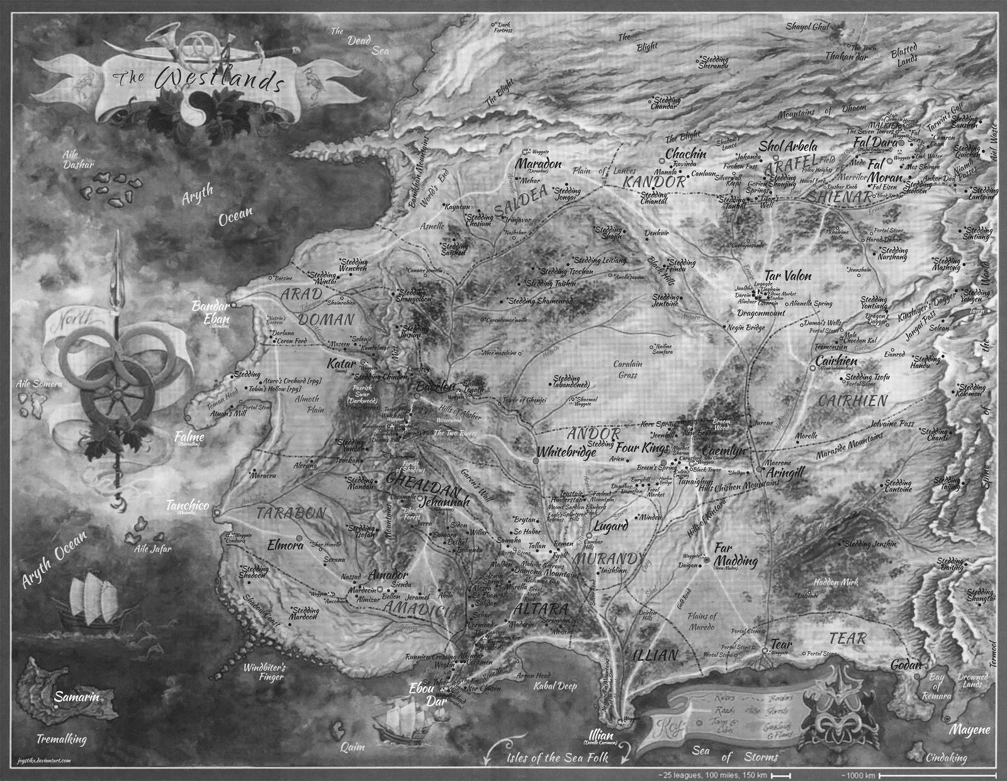
In that part:
The giant sa’angreal are in use, so their crystal spheres are glowing!
This guy, Barmellin, was travelling near Cairhien where there male statue is buried.
In that part:
The female statue is on Tremalking, one of the Sea Folk islands.
Timna is one of the Amayar, the people who live on those islands. They have a prophecy about what will happen when the sphere lights up, and she is excited about being around to see it.
Shadar Logoth
Giant male statue
Giant female statue

Slide 4
The battle:
Cyndane travels to the area, and channels to destroy Rand…
Cadsuane defends Cyndane’s lightnings
Elza attacks where it was coming from
Cadsuane detects more channeling from inside the city…
Rand wonders if his cleansing is working…
It was Demandred inside the city
A dome of darkness is appearing in the city
He travels to escape Elza’s attack, and runs into Flinn and co…
Cyndane hops around to escape. But she wants to get closer…
Osan’gar is in the fight. He was the asha’man Dashiva…
Graendal is in the fight. Verin has come too far to die now…
Aran’gar the Shim is in the fight. Fortunately, Eben was there to detect her channeling saidin…!
Cyndane encounters Alivia…
Moghedien joins the fight. LOL, no she doesn’t…
Rand’s plan seems to be working…
Cadsuane is concerned for Nynaeve and Rand…
Osan’gar has moved in close enough to see Rand. Balefire time…
Elza is a black ajah!
But she kills Osan’gar thinking he is just an asha’man… LUL…
Moggy must have moved around, because she’s now near the dome .
It collapses... and Moggy is sucked in to where it was…
It’s over… saidin is apparently clean, and everyone is exhausted.
Cyndane
Cyndane
Alivia
Moghedien
Jewelery angreals
Tomas
Lan
Daigian
Aran’gar
Min
Moad
Super angreals
Nesune
Nethan
Nynaeve
Beldeine
Bassane
Rand
Eben Hopwill
Harine
Elza
Cadsuane
Osan’gar
Merise
Hair angreals
Jahar Narishma
Callandor
Verin
Kumira
Graendal
Shalon
Damer Flinn
Corele
Demandred
Sarene
Demandred
???
A big hole where
Shadar Logoth
used to be
Moghedien
Shadar Logoth
Orange = Aes Sedai
Black = Asha’man
Pink = Seanchan (former damane)
Blue = Sea Folk
Grey = Warder
Bold = channeler

Slide 5
Earlier part:
The giant sa’angreal are in use, so their crystal spheres are glowing!
This guy, Barmellin, was travelling near Cairhien where there male statue is buried.
Earlier part:
The female statue is on Tremalking, one of the Sea Folk islands.
Timna is one of the Amayar, the people who live on those islands. They have a prophecy about what will happen when the sphere lights up, and she is excited about being around to see it.
The prophecy is that “the time of illusion is at an end”… whatever that means.
Shadar Logoth
Giant male statue
Giant female statue

